Slide 1
DESIGN PROJECT
“ AGRICULTURAL BIOMASS INTO CLEAN ENERGY ”
THEME: CLEAN ENERGY

Slide 2
TEAM MEMBERS:
• N. Navya Sri– 99210042282(III/CSE)
• Divi. MANOJ KUMAR – 9921004859(III/CSE)
• B. Venkata Siva Shankar – 99210042245(III/CSE)
• B. Mani kanta-9921005078(III/CSE)
TEAM NO. : BH145

Slide 3
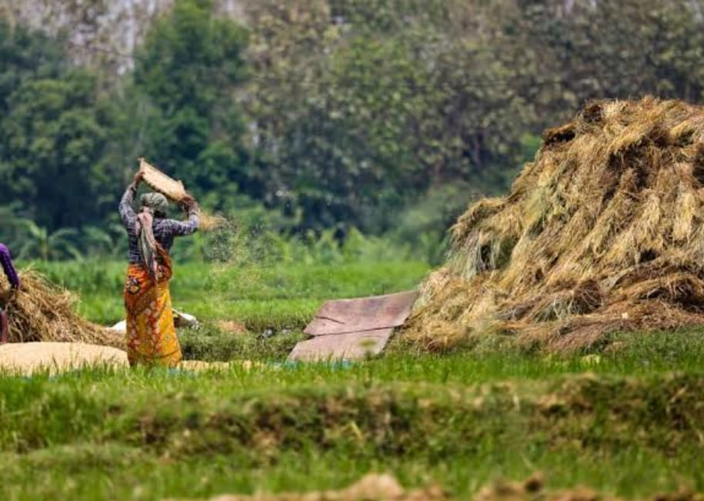
INTRODUCTION:
India is one of the known country for farming. It is the world’s largest producer of rice, wheat, pulses, cotton, sugarcane, etc. In this yield production some biomass/residue is formed. The source of energy generated from the agricultural biomass is the best source which is used in industrial and household purposes like cooking and also to generate electricity. So to generate this energy we have to use an effective way to collect the biomass from various villages which helps the farmers to make it easy to collect the agricultural waste.
.

Slide 4
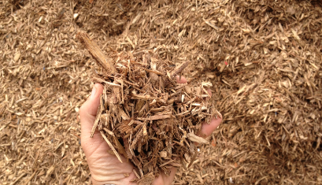
PROBLEM STATEMENT:
Analysis for effective prediction of agricultural biomass availability to regenerate clean energy.
Effectively forecasting the availability of agricultural residues and biomass for the regeneration of clean energy has long been a difficulty in the agricultural and renewable energy industries.
In the past, manual data gathering techniques have been used, which has caused inefficiencies and errors in biomass quantity estimation.
.

Slide 5
EVOLUTION OF PROBLEM STATEMENT:
Because of this, techniques for converting biomass to energy have been hindered by the unpredictability of feedstock supplies, which has reduced the overall effectiveness of producing clean energy.
A potential answer is provided by the development of IoT and machine learning technology.
A complex data analytic system may be created to estimate biomass availability precisely by integrating IoT sensors to gather real-time data on agricultural yields, waste output, and weather trends.
This novel strategy would open the door to the dependable and sustainable use of agricultural wastes as a source of clean energy.

Slide 6
IMPLEMENTATION OF PROJECT:
TWO STEPS:
Hardware implementation
Sensor connection
Conversion of biomass into briquettes(solid wooden bricks)
Software implementation
Sensor coding in Arduino
Sending data to cloud(Thingspeak)

Slide 7
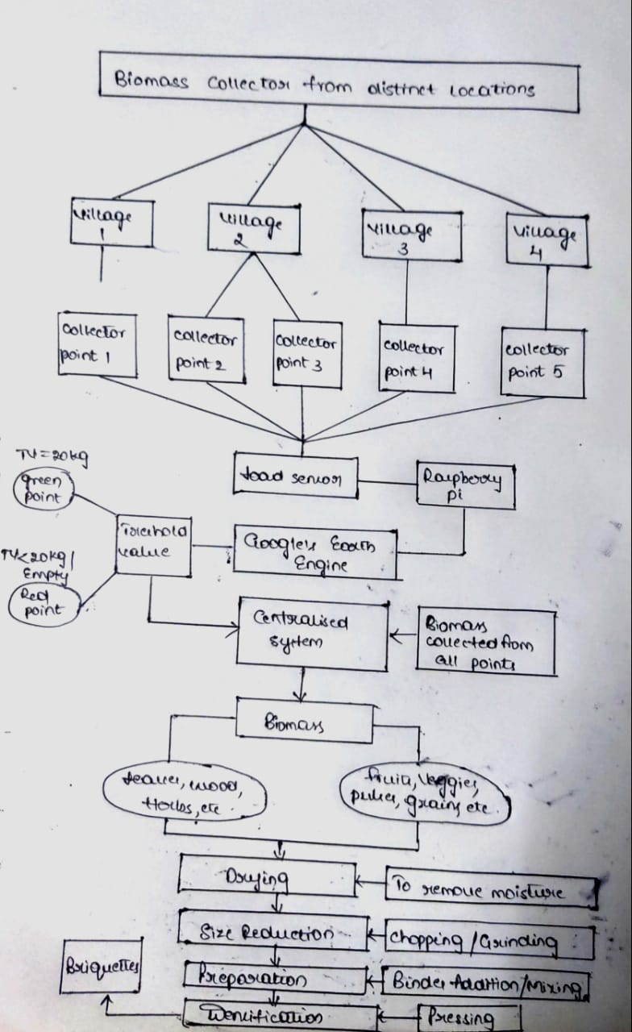
FLOWCHART:
Biomass collection
Thingspeak
Village 1
Village 2
Village 3
Login
Data collector 1
Data collector 2
Data collector 3
Create new channel
Load cell
Get API key and paste in code
Node mcu
Output

Slide 8
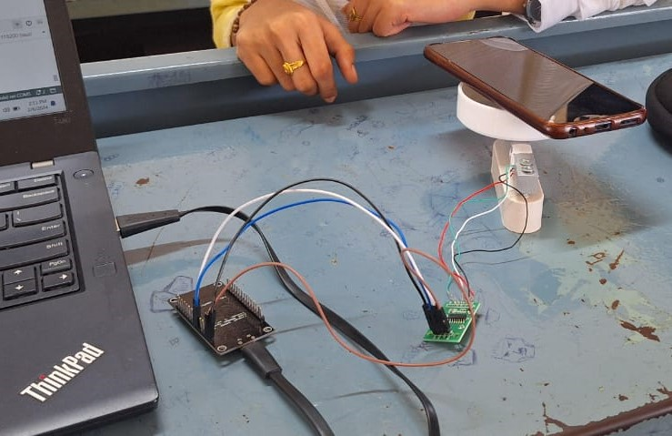
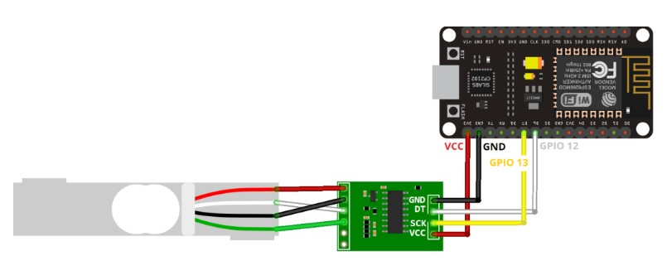
HARDWARE IMPLEMENTATION:
SENSOR CONNECTION:

Slide 9
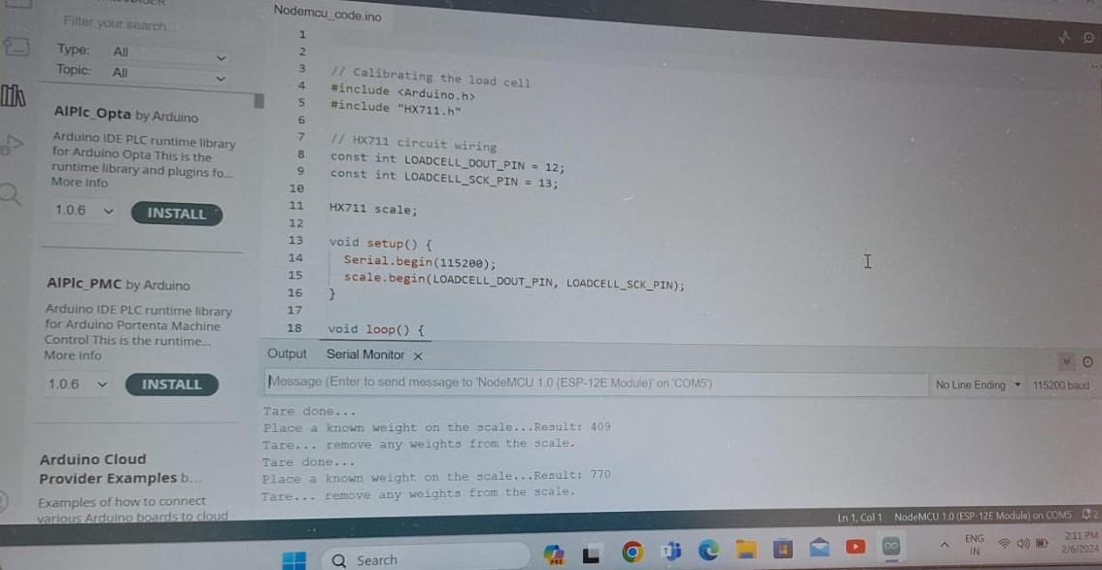
SOFWARE IMPLEMENTATION:
SENSOR CODE IN ARDUINO:

Slide 10
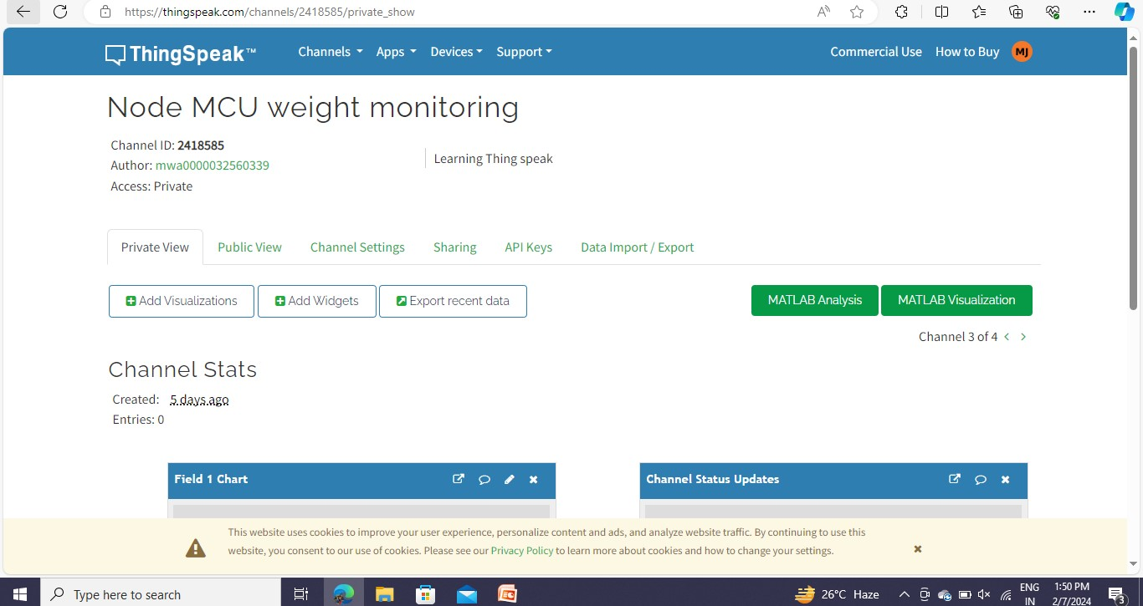
THINGSPEAK

Slide 11
CONCLUSION:
The use of biomass-derived energy carriers instead of fossil fuels could have beneficial effects on the economy, the ecosystem, and human health, among other things. Additionally, generation of biomass-derived energy could be accomplished in any regional setting thanks to the widespread supply of biomass around the globe, which could also help with effective waste stream management. The main obstacles to further increasing the proportion of such green energy transporters are technological advancements to boost output and lower costs. To encourage more investment in the area, efforts should be focused on the creation of more user-friendly, cost-effective technologies at different scales. It's also important to raise knowledge of the benefits of using biomass for the creation of sustainable energy.
Pride Mobility Go Chair

Slide 12
THANK YOU

